Slide 1

Maximizing Transportation Investments with Technology
Advisory Services
2018 ACEC-KY\FHWA\KYTC Partnering Conference September 5, 2018

Slide 2
AGENDA
1
What’s the Issue?
2
ITS - Coordinated Adaptive Ramp Metering
3
Connected and Automated Vehicles
4
Managed Lanes
5
Road Use Charging

Slide 3
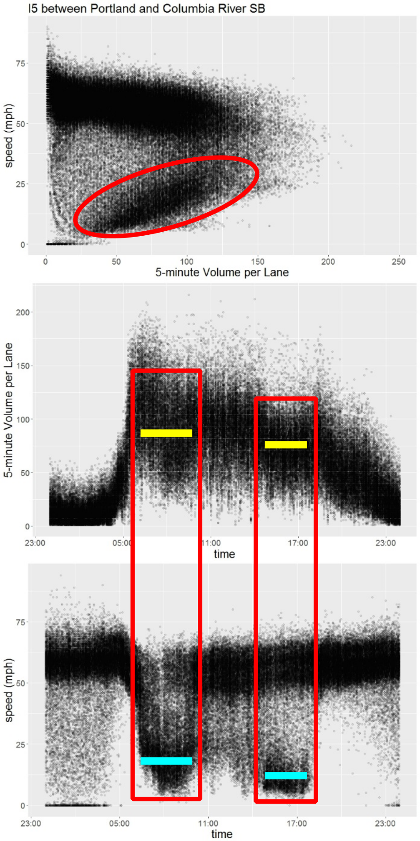
What’s the Issue?
Transportation infrastructure fails operationally at the time it is needed most

Slide 4

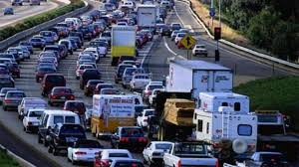
The key is controlling demand during peaks

Slide 5
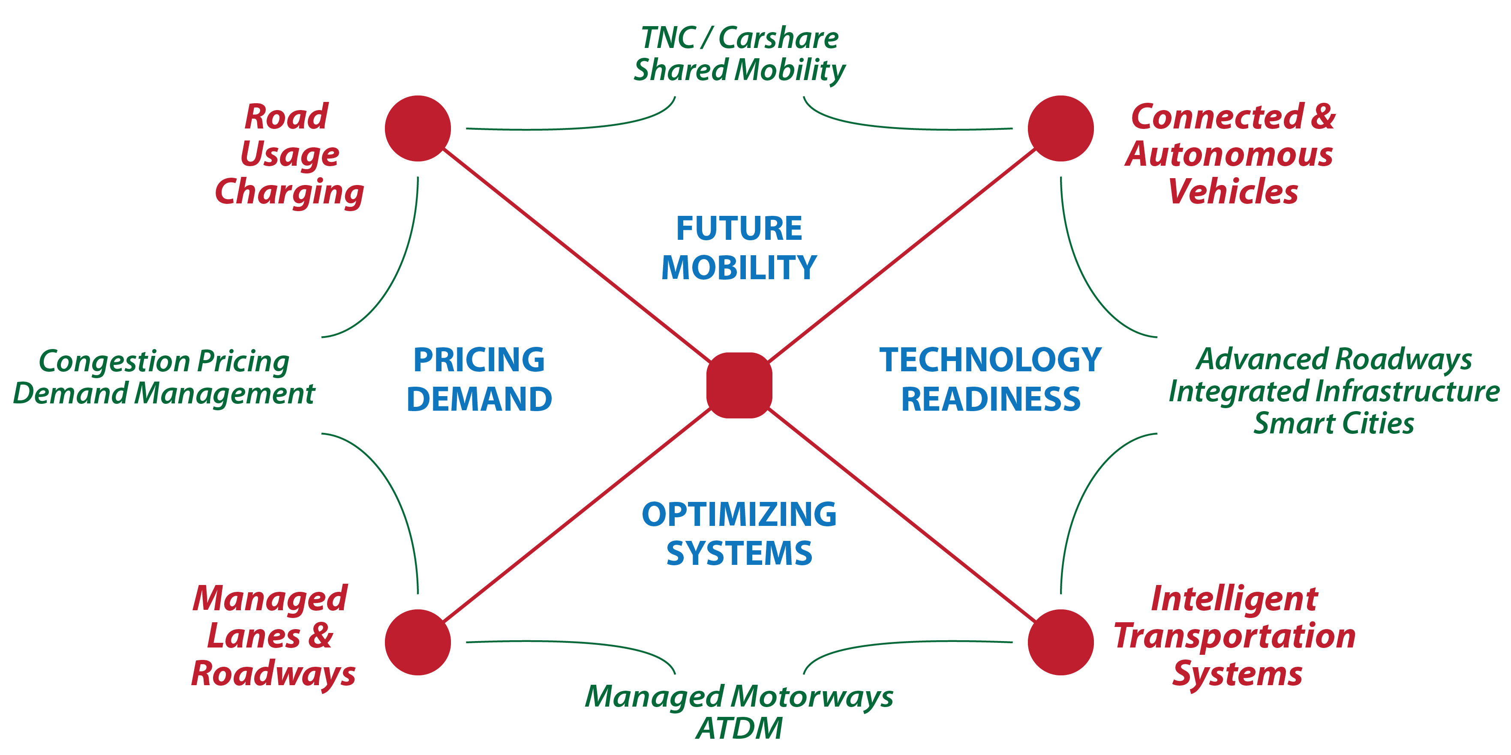
The solution will require an Integrated, Interconnected Process

Slide 6
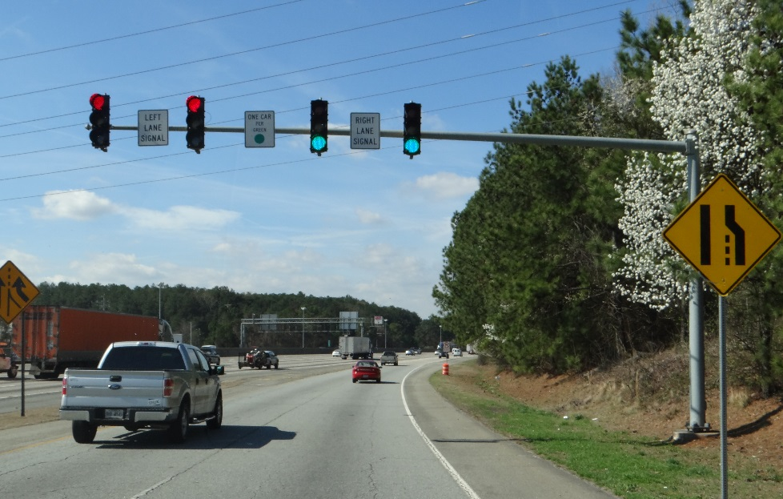
Coordinated-Adaptive Ramp Metering (CARM)
Accurate and integrated data collection sensors
Whole system monitoring
  Freeway
  Ramp
  Arterial
Synchronizes entering flow of vehicles onto the freeway
Real time demand management
maximizes overall efficiency

Slide 7
CARM Focuses on Maintaining Stable Flow and Maximizing Vehicle Throughput
Planning and Operations with aggregate data
Actual traffic flows, volatile over short time frames
CARM optimizes traffic flows to match these fluctuations and avoid traffic flow breakdown.
2400
2,250 vphpl
2000
1600
1,300 vphpl
Traffic flow (vphpl)
1200
800
400
0
0:00
2:00
4:00
6:00
8:00
10:00
12:00
14:00
16:00
18:00
20:00
22:00
1 minute
Hourly average

Slide 8
CARM Works to Maintain Stable Flow to Maximize Vehicle Throughput
Uncontrolled Freeways may achieve optimal flow rates for very short periods of time before breaking down.
CARM maintains flow rates at near optimal levels continuously.
  Coordinated ramp metering controls the amount of traffic entering the freeway to prevent breakdown.
  ATM elements can help further fine tune traffic flows, especially during incidents.
Uncontrolled Freeway
Managed Freeway
Source: VicRoads

Slide 9
…….and we’ve seen it to the South

Slide 10
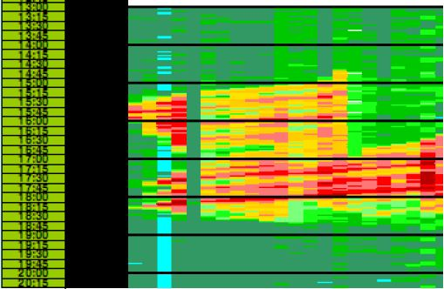
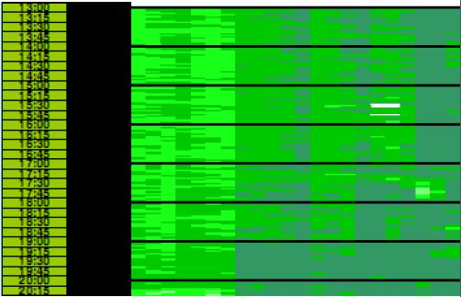
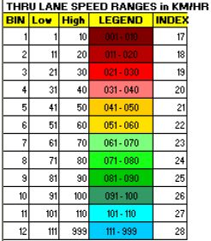
Managed Motorways Down Under
Australian Managed Motorways is a system of approaches that includes a highly evolved CARM system to minimize instability in traffic flows:
  Integrated system ensures components work together to sustain traffic flows.
  Bottlenecks are substantially eliminated.
M1 Managed Motorway Speed Contour Plot (PM Peak Period Monash Motorway Outbound)
Before Managed Freeways (2007) After Managed Freeways (2010)
M
Legend
Speed Ranges (km/h)
1PM
1PM
3PM
3PM
5PM
5PM
7PM
7PM
Source: VicRoads

Slide 11
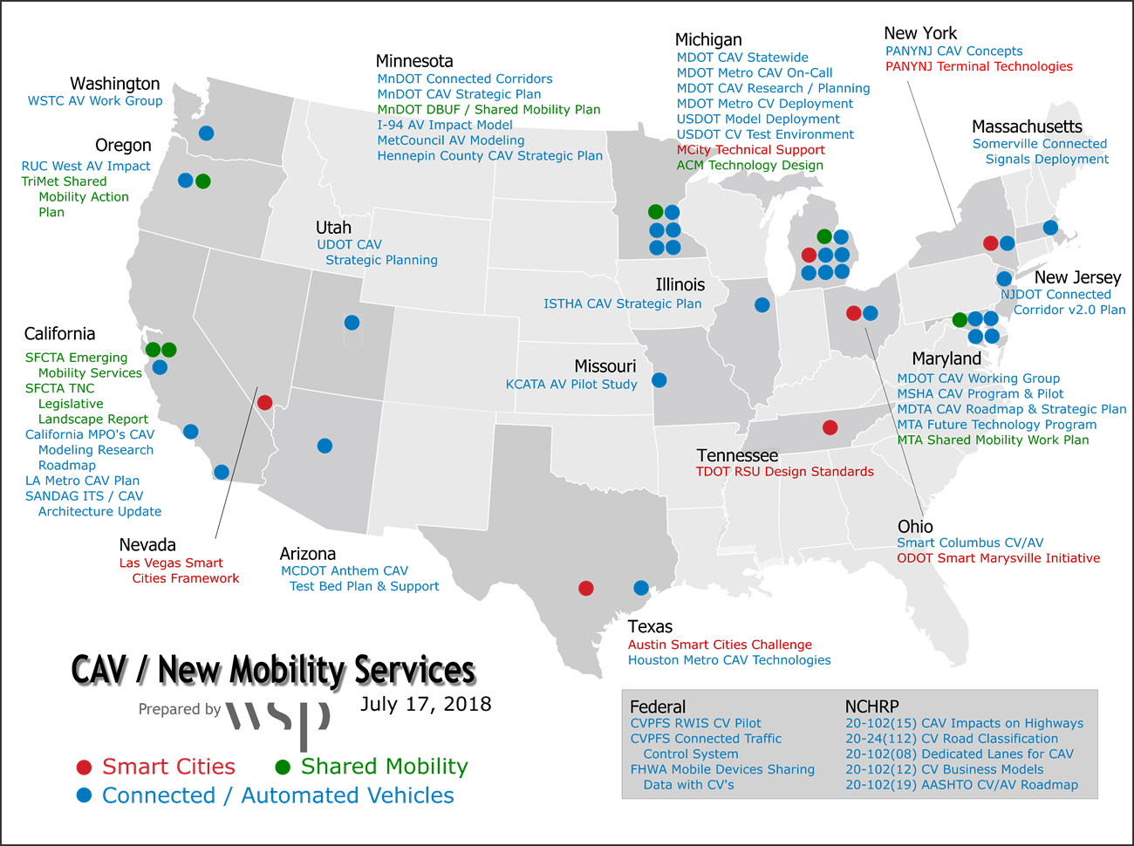
Connected / Automated Vehicles
Premier Provider of Leading-Edge Services

Slide 12
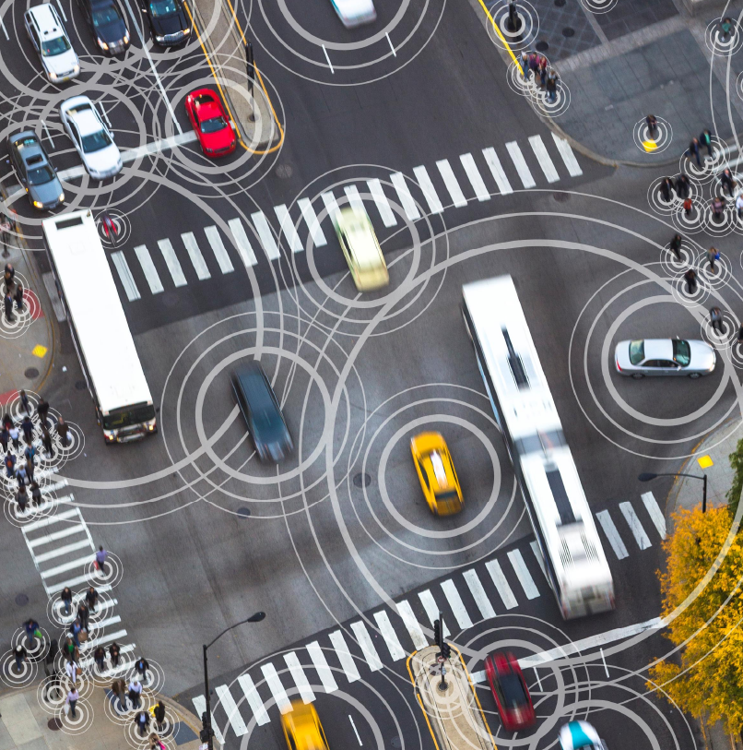
Long Term Changes from Vehicle Automation
Are systems scalable and compatible with a connected vehicle environment?
  Data management
  Communications network capacity
  Data sharing agreements
  IT / network security
Are forecasts reliable with a C/AV future?
  Travel forecasts based largely on extrapolating historic trends
  Disruption in the trend line within our planning horizon
  Yields demand and revenue implications

Slide 13
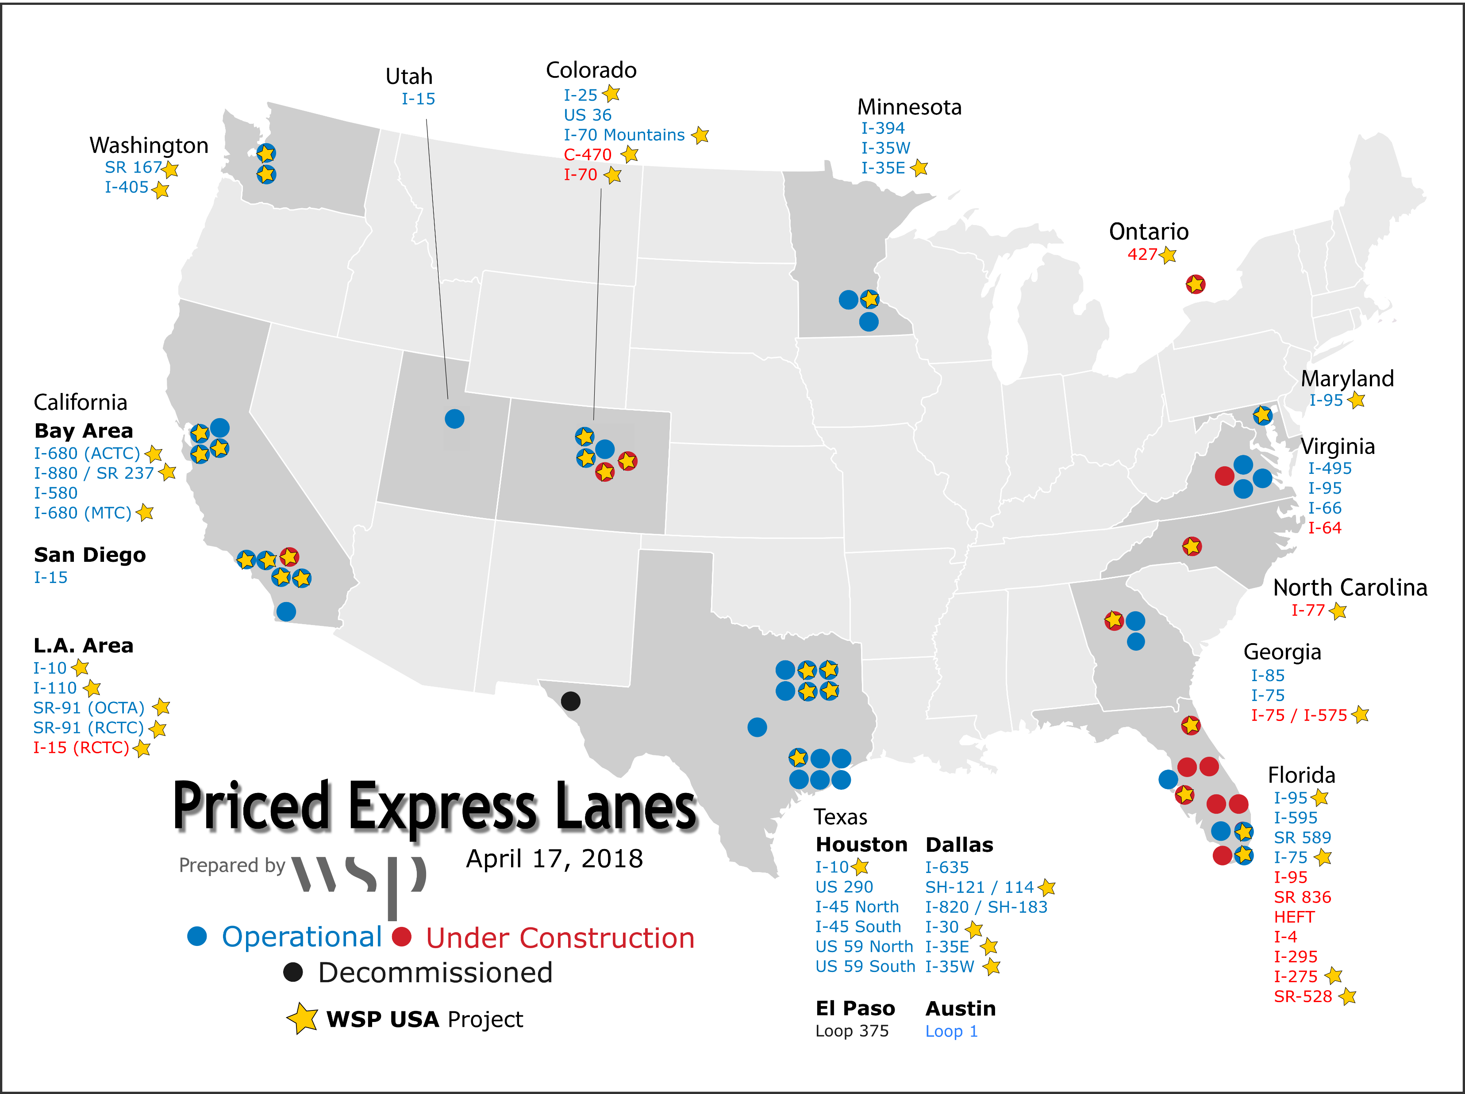
Managed Lanes
25+ Years of Success in the US

Slide 14
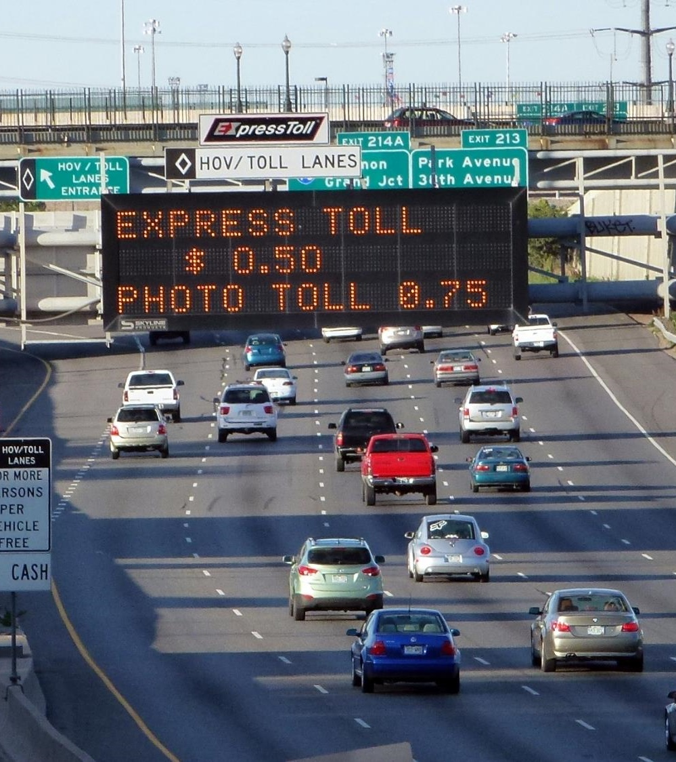
Managed Lanes
It’s a Choice
    Option to meet the requirements to use the Managed Lanes or use the general purpose lanes

Slide 15
“Congestion pricing is a way of harnessing the power of the market to reduce waste associated with traffic congestion. [It] works by shifting discretionary rush-hour highway travel to other modes or off-peak periods, [as] the majority of rush-hour drivers on a typical urban highway are not commuters. By removing even as small as 5% of the vehicles from a congested roadway, pricing enables the system to flow much more efficiently, allowing more cars to move through the same physical space.”
—FEDERAL HIGHWAY ADMINISITRATION
Congestion Pricing – A Primer, October 2008

Slide 16
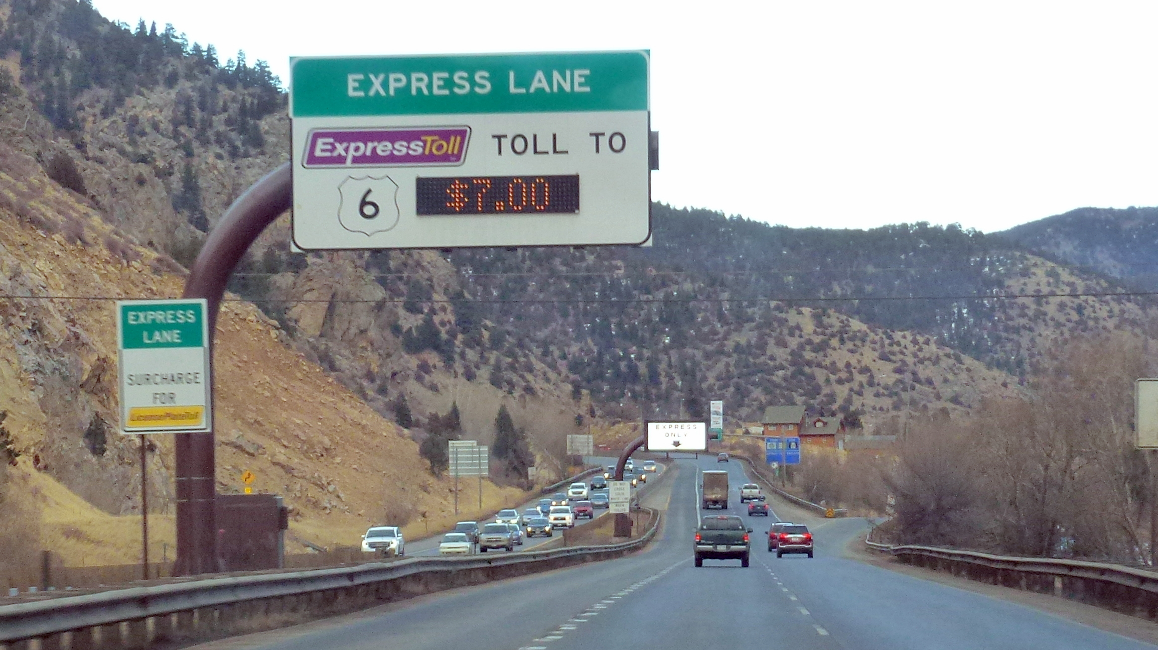
Why Express Lanes?
Express Lanes provide higher travel speeds, shorter and more reliable travel times, and a higher quality of travel than general purpose lanes.

Slide 17
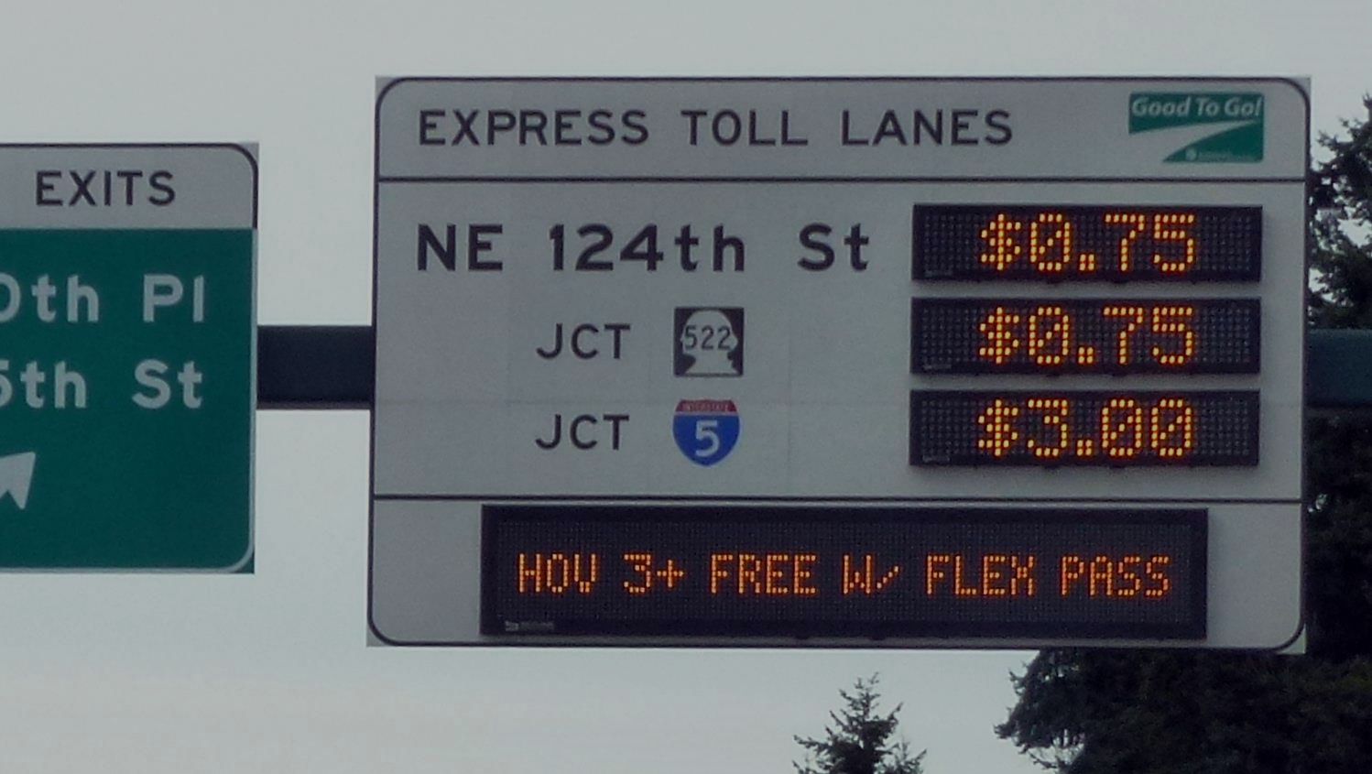
Variable Pricing
Variable Pricing has been proven to better maintain speeds and travel times, encourages travel by other modes or time periods, and efficiently manages capacity.

Slide 18
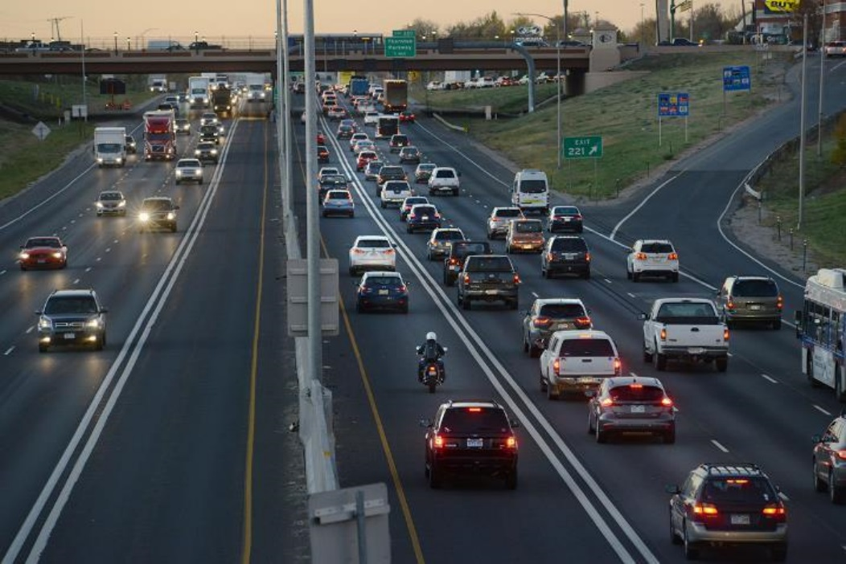
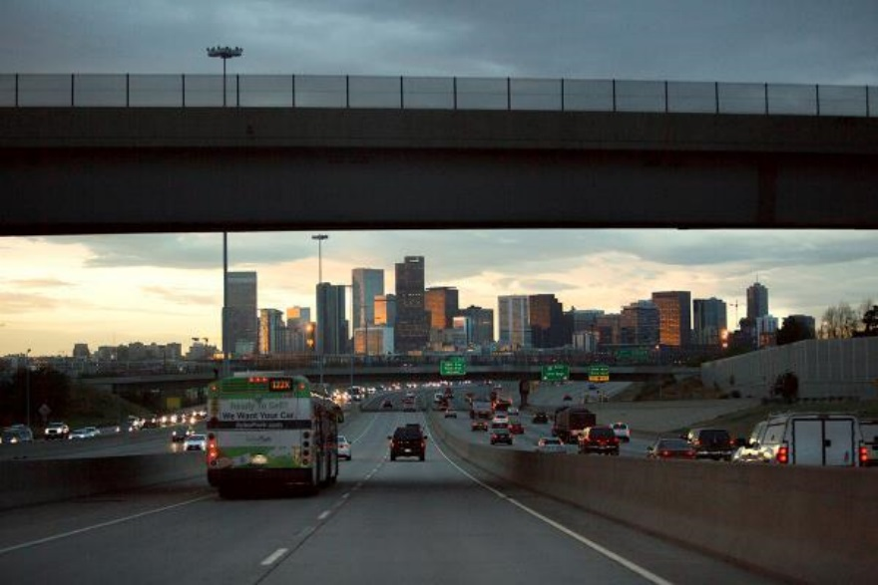
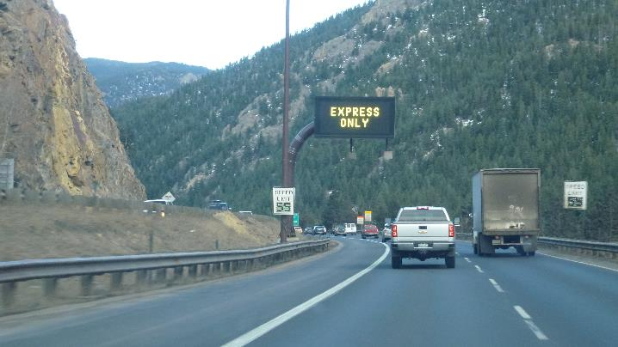
Design
Multiple Options to Fit Context
  Buffer Separation
      Paint striping only
  Barrier Separation
      Concrete barriers prevent movement
  Channelizer Separation
      Plastic pylons discourage movement

Slide 19
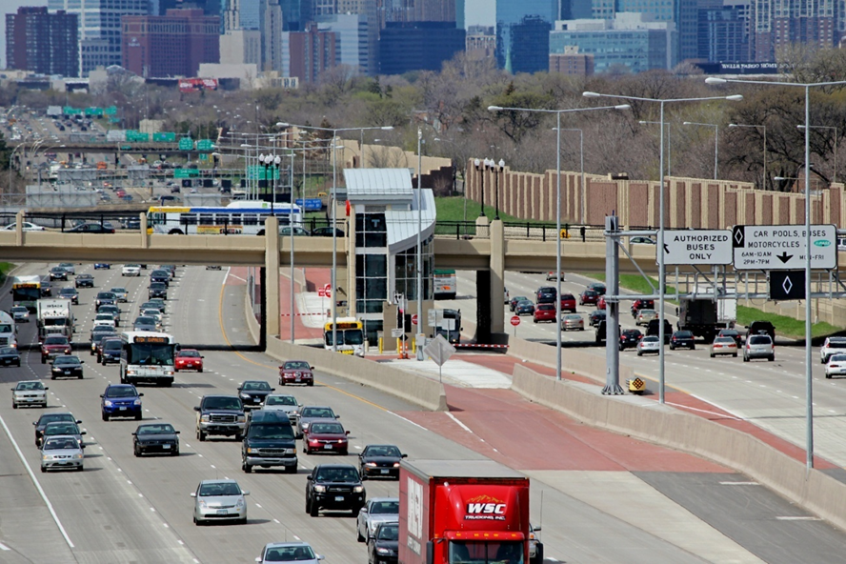
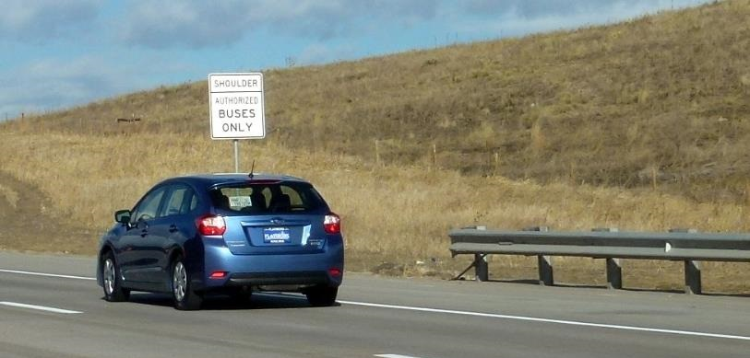
Transit
Transit Systems Incorporation
  Shoulder Use for Buses
      Easiest access to offline bus stations
  Inline Stations
      Mainline access to buses for quick boarding

Slide 20
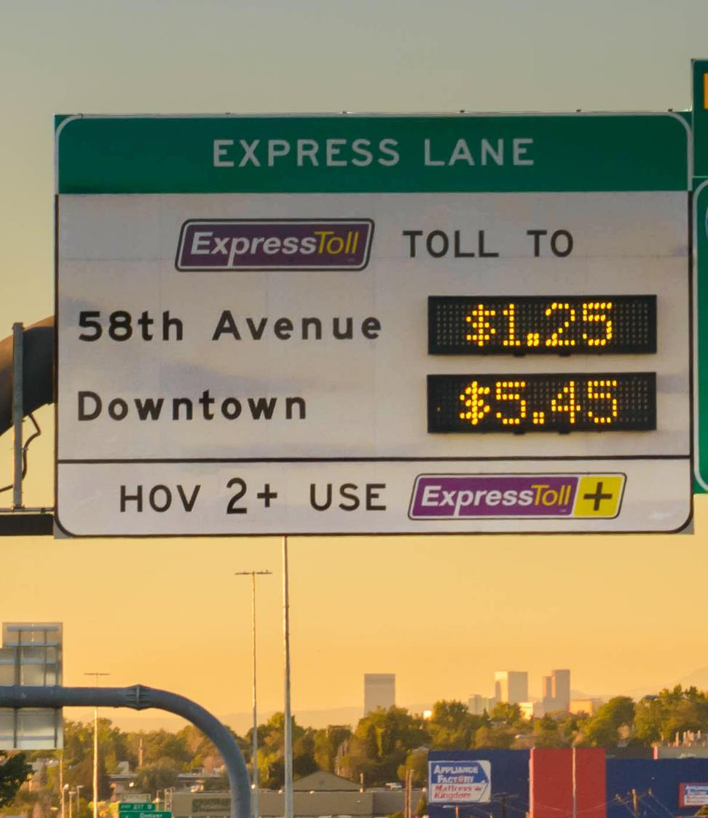
Options
  Price, access and eligibility
  Different design criteria
  Dynamic vs time-of-day pricing
  Who pays a toll and how much
  Complementary traffic management strategies
Requirements
  Regular, recurring congestion
  At least 3 lanes (2 GP + 1 EL)
  Commitment to operate

Slide 21
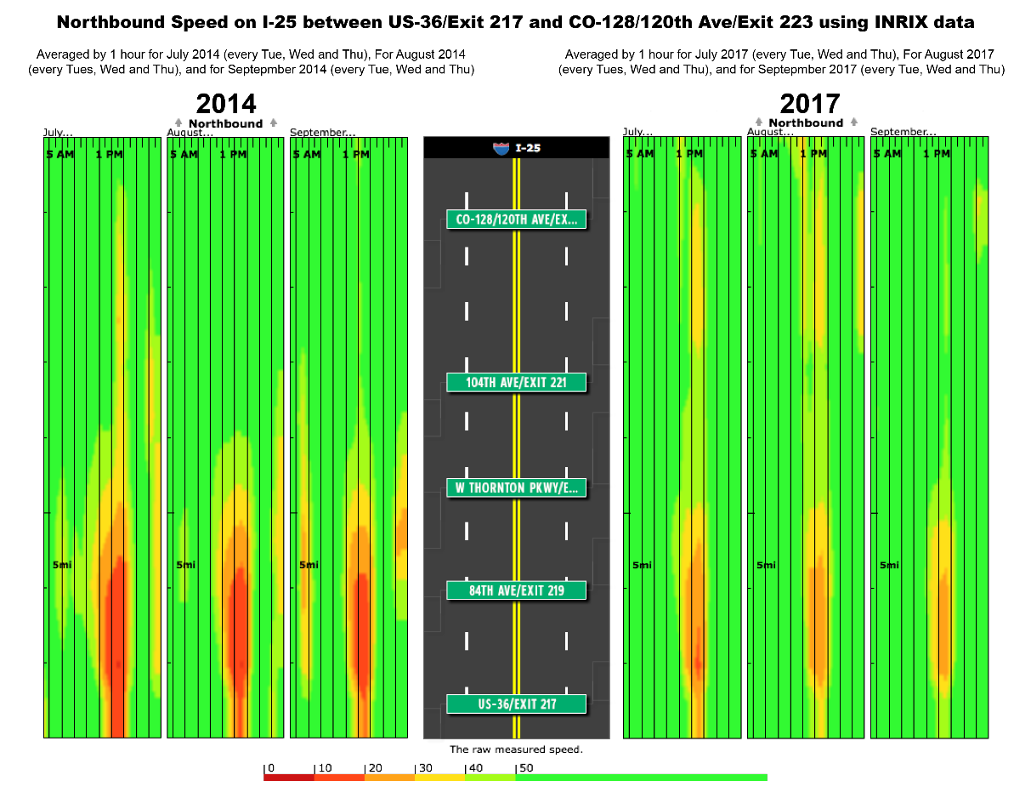
I-25 North Express Lanes Results:
Comparing 2014 to 2017

Slide 22
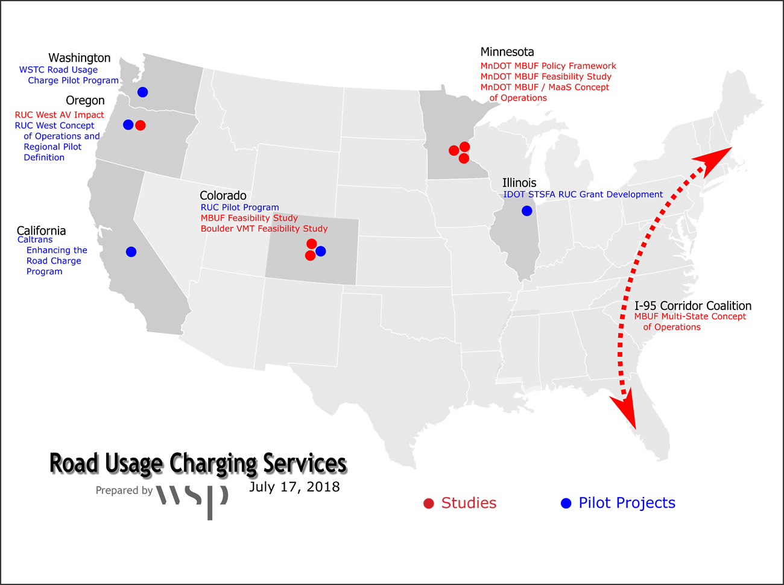
Road Usage Charging
Full Solution Feasibility and Pilot System Development
July, 2018

Slide 23
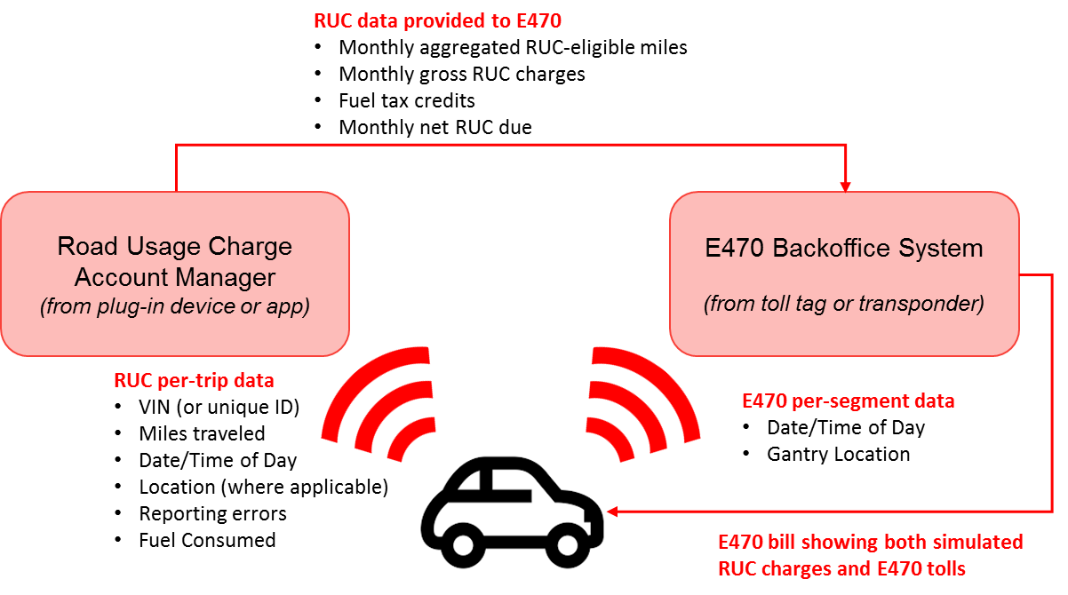
CDOT RUC Phase 2 Pilot
Leverage Federal grant to demonstrate interoperability between RUC and tolling
Integrate RUC data into E-470 back-office
Demonstrate single user bill for E-470 tolls and simulated RUC charges
Demonstrate how E-470 can help Colorado achieve economies of scale through a single revenue collection hub

Slide 24
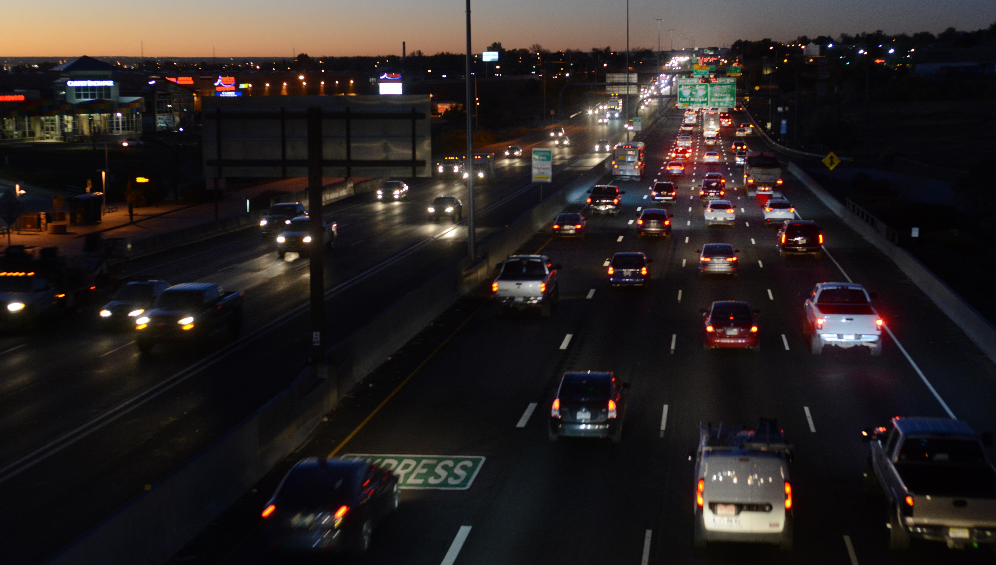
Change is as Institutional as it is Technical
States are becoming more dependent on technology based solutions
  Discussions test relationships
  Leaders change as does support
Building trust in the use of technology
  Not intrinsically obvious
  Transparency is required
Pilot Programs
  Measure rather than model
  Provides the assurance of a limited time period in case a concept doesn’t produce results

Slide 25
Christopher Swenson, PE
SE Managed Lanes Director chris.swenson@wsp.com
770-847-0525
Advisory Services
Christopher Barrow, PE
ITS/Traffic Engineer
chris.barrow@wsp.com
859-245-3884
2018 ACEC-KY\FHWA\KYTC Partnering Conference September 5, 2018

